Slide 1
Day 4 - Agenda
Module 9:Spring Boot Fundamentals
What is Spring Boot?
Spring framework vs Spring Boot
Starters, Auto-Configuration
Project structure overview
application.properties vs application.yml
Spring Boot lifecycle & internals
Module 10: Spring Boot Foundations + REST API
REST API Development
Controllers & REST Mappings
RequestBody, PathVariables, Query Params
ResponseEntity
DTOs vs Entities
Serialization/Deserialization with Jackson
Build CRUD endpoints (dummy data) • Implement DTO layer • Build response wrapper
Module 11 : Spring Boot Architecture Patterns
Controller → Service → Repository
Dependency Injection
Component scanning
Why layered architecture matters
Refactor controllers to use service layer • Inject services via @Service & @Autowired
• What is Spring Boot?
• Spring framework vs Spring Boot
• Starters, Auto-Configuration
• Project structure overview
• application.properties vs application.yml
• Spring Boot lifecycle & internals
Hands-on Labs • Create new Spring Boot project • Explore auto-configuration • Run first REST endpoint
• What is Spring Boot?
• Spring framework vs Spring Boot
• Starters, Auto-Configuration
• Project structure overview
• application.properties vs application.yml
• Spring Boot lifecycle & internals
Hands-on Labs • Create new Spring Boot project • Explore auto-configuration • Run first REST endpoint
• What is Spring Boot?
• Spring framework vs Spring Boot
• Starters, Auto-Configuration
• Project structure overview
• application.properties vs application.yml
• Spring Boot lifecycle & internals
Hands-on Labs • Create new Spring Boot project • Explore auto-configuration • Run first REST endpoint

Slide 2
Spring Boot + Spring Rest

Slide 3
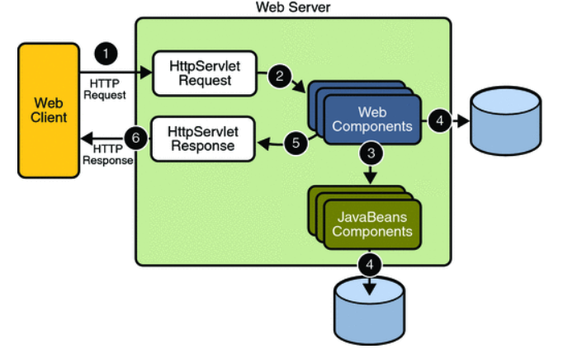
What is Web Programming?

Slide 4
Why Spring Boot
Rapid Development:
  Spring Boot follows the principle of convention over configuration, minimizing boilerplate code and allowing developers to focus on business logic.
  Starters and auto-configuration features accelerate project setup and development.
Microservices Architecture:
  Well-suited for building microservices due to its modular and lightweight nature.
  Supports the development of independently deployable and scalable services.
Embedded Server Support:
  Comes with embedded server support (Tomcat, Jetty, Undertow), reducing the need for external server setup.
  Simplifies deployment and makes it easier to create self-contained, executable JARs.
Opinionated Defaults:
  Spring Boot provides sensible defaults for various configurations, reducing the need for manual setup.
  Developers can easily override defaults when needed, offering a balance between convention and customization.
Spring Ecosystem Integration:
  Seamless integration with the broader Spring ecosystem, including Spring Data, Spring Security, and Spring Cloud.
  Leverages the power of the Spring framework for building enterprise-level applications.
Built-in Features:
  Includes built-in features such as health checks, metrics, and monitoring through Spring Boot Actuator.
  Simplifies the implementation of common tasks like security, caching, and messaging.
Community and Documentation:
  Large and active community support provides access to a wealth of knowledge and resources.
  Comprehensive documentation and tutorials make it easy for developers to get started and troubleshoot issues.
Enterprise-Ready:
  Spring Boot is designed to address the requirements of enterprise-level applications.
  Offers features like transaction management, security, and scalability out of the box.
Cloud-Native Development:
  Well-suited for cloud-native development, with features like Spring Cloud for building distributed systems and handling microservices communication.
Java Ecosystem Compatibility:
  Integrates seamlessly with the Java ecosystem, allowing developers to leverage a wide range of Java libraries and tools.

Slide 5
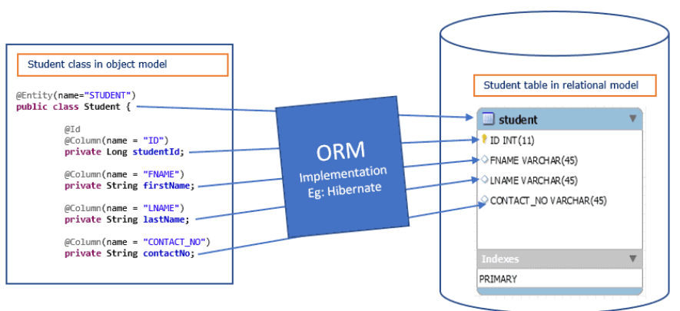
ORM – Object Relational Mapping
Object Relational Mapping is a system that implements the responsibility of mapping the Object to Relational Model.
Easy to interact with database.
Used in the Data layer of the applications

Slide 6
Why ORM?
When work with object oriented programming to persist data in RDBMS, there is mismatches between object model and relational model if work with traditional techniques like JDBC. ORM fills gap in the following mismatches between Object model and relational model.

Slide 7
JPA
JPA (Java persistence API) is not a tool or not a framework, JPA is a specification for accessing, persisting and managing data between Java Objects and Relational Database.
The Java Persistence API provides a POJO persistence model for object-relational mapping.
Technically JPA is just set of interfaces (Specification) and thus require an implementation.
It needs ORM(Object Relational Mapping) implementation to work with and persist Java Objects.
The API defined in javax.persistence package.
JPA defines a standard way for simplifying database programming for developers, reduce development time and increase productivity.

Slide 8
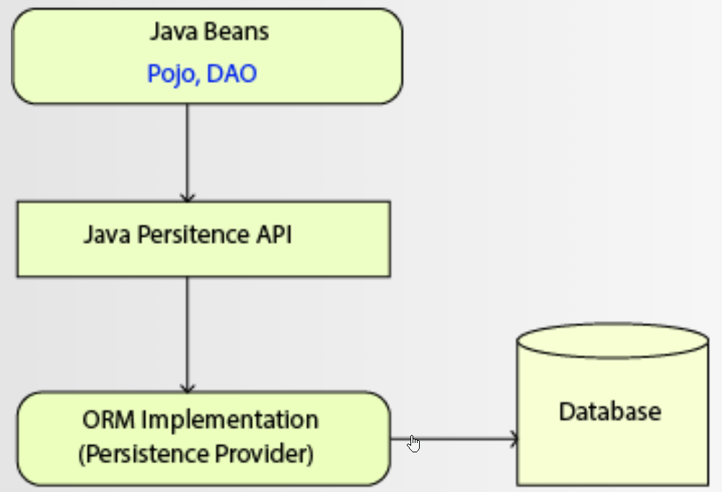
JPA Implementation

Slide 9
Spring Data JPA on top of JPA
No-code Repositories
Reduced boilerplate code
Generated queries

Slide 10
Repository in Spring Data JPA
CrudRepository
  - offers standard create, read, update and delete operations.
PagingAndSortingRepository
  - adds findAll methods that enable you to sort the result and to retrieve it in a paginated way.
JPARepository
  - like flush() to trigger a flush on the persistence context or findAll(Example<S> example) to find entities by example, to the PagingAndSortingRepository.

Slide 11
Spring Data JPA Annotations
@Entity – This annotation marks the class annotations.
@Table – This annotation creates table in database.
@Id – It creates primary key in table.
@GeneratedValue – It defines primary key generation strategy like AUTO,IDENTITY,SEQUENCE etc.
@Column – It defines column property for table.

Slide 12
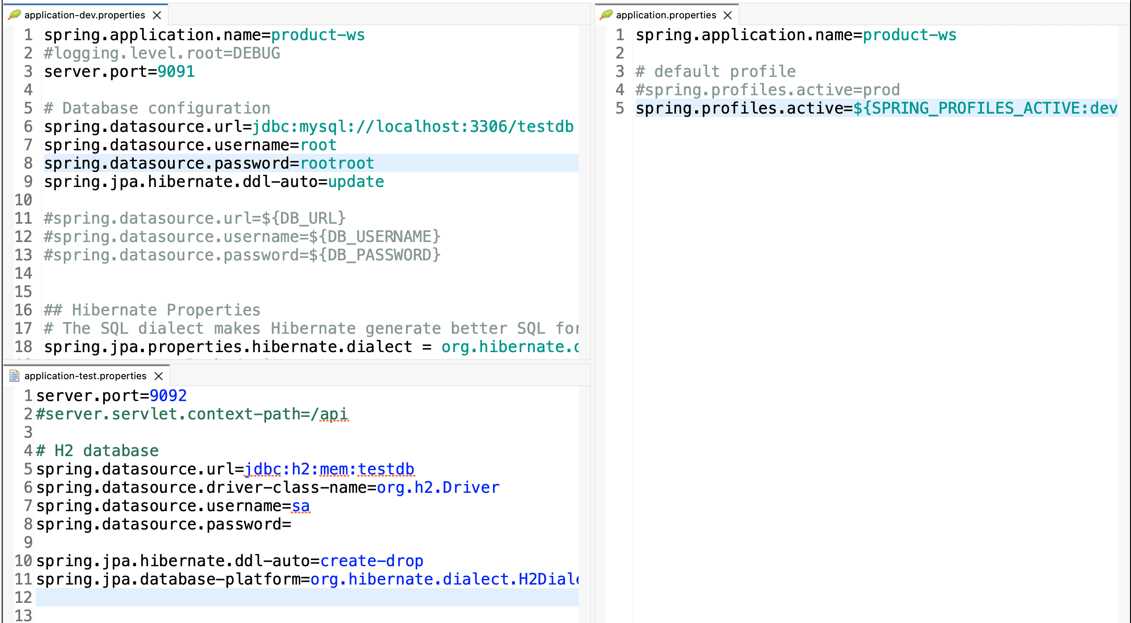

Slide 13
Externalized configuration
Externalized configuration in Spring Boot allows us to separate environment-specific configuration from application code using properties files, environment variables, profiles, and external sources. This enables the same application artifact to run in dev, test, and prod without code changes.

